Slide 1
Real-Time Scheduling (3)
Computer Science & Engineering Department
Arizona State University
Tempe, AZ 85287
Dr. Yann-Hang Lee
yhlee@asu.edu
(480) 727-7507
set 9_ <number>

Slide 2
Scheduling Aperiodic/Sporadic Tasks
Assumptions:
  Preemptive, priority-driven algorithms
  Jobs independent of one another with arbitrary interrelease times
Periodic Jobs
  parameters and priority driven algorithm given
  on their own, periodic jobs meet all deadlines
Aperiodic Jobs
  parameters not necessarily known on release
Sporadic
  Parameters known on release
  variable execution time
  arbitrary deadline
set 9_ <number>

Slide 3
Scheduling Architecture
Aperiodic, Sporadic scheduling algorithms:
  all periodic tasks meet their deadlines
  Sporadic jobs: on arrival, undergo acceptance test. Must not affect periodic jobs and already accepted sporadic jobs.
  Aperiodic jobs: Optimize response time (average) without affecting periodic and accepted sporadic jobs
Periodic Jobs
Aperiodic Jobs
Dispatcher
Processor
Acceptance
Test
Accept
dispatch highest
priority job
Sporadic Jobs
Priority
Queues
Reject
set 9_ <number>

Slide 4
Approaches: Aperiodic
Background: scheduled when processor is idle
Interrupt-driven: scheduled on arrival
Slack-Stealing: postpone execution of periodic tasks only when it is safe to do so
  Well-suited for clock-driven environments.
  What about priority-driven environments? (quite complicated)
Periodic server: defined by (p_{s}, e_{s}). Budget replenished at p_{s} intervals. If scheduled and queue empty then budget set to 0.
Bandwidth-preserving server: Improves on the periodic server by preserving budget (bandwidth) when aperiodic queue is empty:
  Deferrable servers
  Sporadic Server
  Constant utilization and Total bandwidth servers
set 9_ <number>

Slide 5
Background Scheduling and Polling
Background
  Aperiodic tasks are executed when there is no periodic task to execute.
  Simple, but no guarantee on aperiodic schedulability nor response time
Interrupt-driven
  the arrival of an aperiodic task triggers an interrupt. CPU runs the task as an ISR
Polling
  with a polling period p_{s} and a reserved execution time e_{s}
  schedule polling server as a periodic task
  examine the aperiodic tasks queue
    if not empty, run aperiodic tasks for at most e_{s}
    if empty, the server suspends itself during its current period and gets invoked again at its next period.
    The computation time allowance for the server is replenished at the start of its period
set 9_ <number>

Slide 6
Example of a Polling Server
T₁
T₂
T_{a}
T₃
To prove it works
  the polling server is periodic and has a WCET of e_{s}
When the polling server is eligible and there is no aperiodic task
  the budget is lost
Combine with a background server
set 9_ <number>

Slide 7
Aperiodic Servers
A service thread waiting for the external trigger(s)
  fixed execution budget
  replenishment interval (period)
Can be compared to periodic tasks
  if it is ready, run according to priority scheduling scheme
Priority adjusted to meet requirements
Issues:
  How to reserve the bandwidth when no aperiodic task exists
  how to replenish the budget.
  Example: Polling server
    no bandwidth preserving
    fixed replenishment time
set 9_ <number>

Slide 8
Deferrable Server
A periodic server task is created.
  When the server is invoked with no outstanding aperiodic tasks, the server does not execute but defers its assigned time slot.
  When an aperiodic task arrives, the server is invoked to execute aperiodic tasks and maintains its priority.
Unlike the priority exchange policy, the server’s time is preserved at its initial priority.
The computation time allowance for the server is replenished at the start of its period.
Provides better response time for aperiodic tasks than Polling server
set 9_ <number>

Slide 9
Deferrable Server (DS)
Periodic task (p_{s}, e_{s}) model with rules:
  budget consumed only when executing
  budget replenished at kp_{s}, budget = e_{s} at kp_{s}
T₁
T₂
T_{a}
budget
T₃
set 9_ <number>

Slide 10
Deferrable Server
Aperiodic requests arrive at a queue.
The head of queue request checks if there is budget available.
If there is a budget left,
  the aperiodic request runs until either the request is served
  or the budget is exhausted
  and therefore the aperiodic request is suspended until there is new budget available
else the aperiodic request is suspended and it waits until there is new budget available
When the budget >> requests workload, requests seldom suspend. It has interrupt like service if the deferrable server is running at a high priority.
When the budget << requests workload, it behaves just like polling.
set 9_ <number>

Slide 11
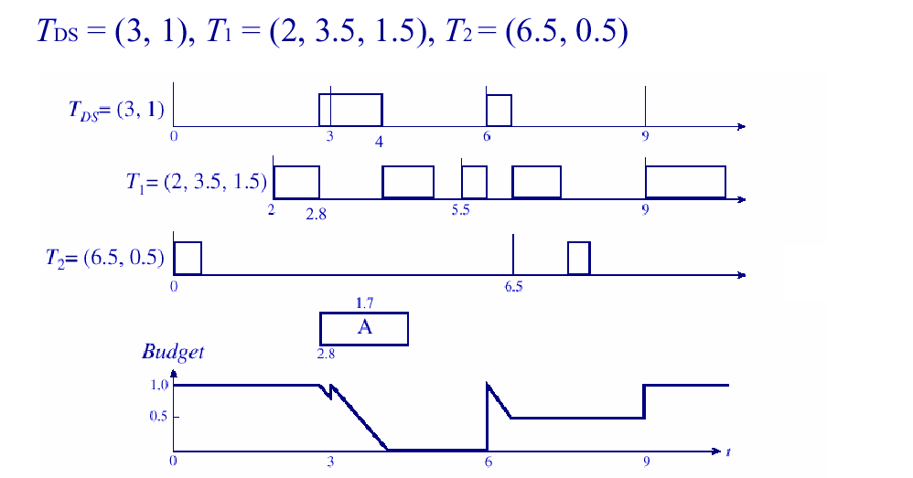
Example: Deferrable Server with RM
set 9_ <number>

Slide 12
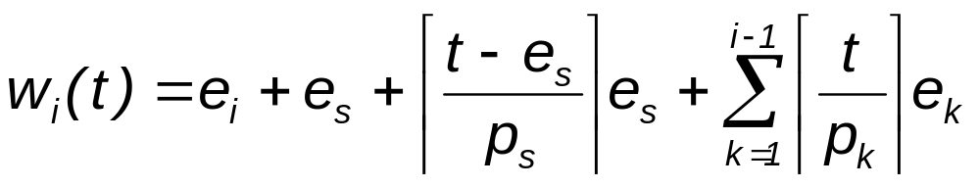
Schedulability - Fixed Priority
Time demand analysis:DS has highest priority
  Critical instant at t₀: Low-priority tasks suffer from a “back-to-back” hit by the deferable server.
  DS budget is e_{s} at t₀
  server remains backlogged after t₀.
  DS replenished at t₀ + e_{s}
...
T_{a}
...
T_{i}
t₀
t₀ + e_{s}
t₀ + e_{s} + p_{s}
t₀ + e_{s} + 2p_{s}
t₀ + p_{i}
set 9_ <number>

Slide 13
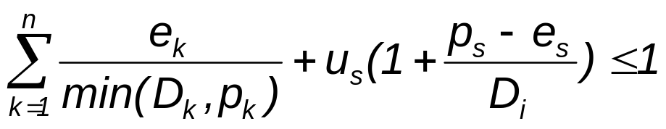
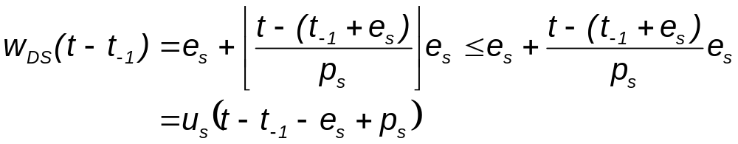
Schedulability - Dynamic Priority
Independent periodic tasks and one deferrable server, a task T_{i} is schedulable according to EDF if:
Prove by calculating processor time required for the deferrable server
  time bound for periodic tasks is e_{k}(t – t₋₁)/p_{k}
  t-t₋₁ = D_{i}, relative deadline for task T_{i}
set 9_ <number>

Slide 14
Priority Exchange Server
A periodic server task is created.
  When the server invoked, the server runs if there are any outstanding aperiodic tasks.
  If no aperiodic task exists, the high priority server exchanges its priority with a lower priority periodic task for a duration of e’_{s}, where e’_{s} is the remaining computation time of the server.
  In this way, the priority of the server decreases, but its computation time is maintained.
The computation time allowance for the server is replenished at the start of its period.
As a consequence,
  the aperiodic tasks get low preference for execution and worse response time compared to Deferrable Server.
  better schedulability bound for periodic task set compared to Deferrable Server
set 9_ <number>

Slide 15
Sporadic Servers
The deferrable server has this one additional preemption and reduces the schedulability of periodic tasks.
Vary the points at which the computation time of the server is replenished, rather than merely at the start of each period.
  allows to enhance the average response time for aperiodic tasks without degrading the utilization bound for periodic tasks
  any spare capacity (i.e., not being used by periodic tasks) is available for an aperiodic task on its arrival
Sporadic server (p_{s}, e_{s}) does not demand more processor time than a periodic task with the same parameters
5
Execution budget
5
5
100
200
300
5
5
100 ms
100 ms (SS period)
set 9_ <number>

Slide 16
Definitions
T = set of n independent, preemptable periodic tasks.
T_{H} = subset of T with higher priorities than the sporadic server
t_{r} = latest replenishment time.
t_{f} = first instant after t_{r} that the server begins to execute
t_{e} = latest effective replenishment time
  when the current server period begins
BEGIN = at any time t, instant of earliest busy interval of tasks in T_{H}
END = end of the latest busy interval if ends before time t, otherwise infinity.
set 9_ <number>

Slide 17
Simple Sporadic Servers - Fixed Priority
Replenishment time: Effective = t_{e}, actual = t_{r}
Consumption rule at time t>t_{r}: when either
  C1: server is executing
  C2: server has executed since t_{r} and END < t (i.e. this is not a busy interval)
  C1 is to consume the server budget when it is executing
  C2 implies the server budget should be consumed as all high priority jobs are done and the server period has started.
    Or, the server budget is consumed as if there is a sporadic job during the current server period.
set 9_ <number>

Slide 18
Simple Sporadic Servers - Fixed Priority
Replenishment rule at time t
  R1: Initially when system begins execution and when replenished, budget = e_{s} and t_{r} = t (current time).
  R2: at time t = t_{f}, (the serve begins to execute…)
    if END = t_{f} then t_{e} = max(t_{r}, BEGIN).
    If END < t_{f} then t_{e} = t_{f}.
    next replenishment time t_{next} = t_{e} + p_{s}
  R3: Replenish at t_{next} except when:
    (a) If t_{next} < t_{f}, then replenish when exhausted
    (b) Else if T becomes idle before t_{next}, and becomes busy at t_{b}, budget replenished at t_{next} = min(t_{e} + p_{s}, t_{b})
set 9_ <number>

Slide 19
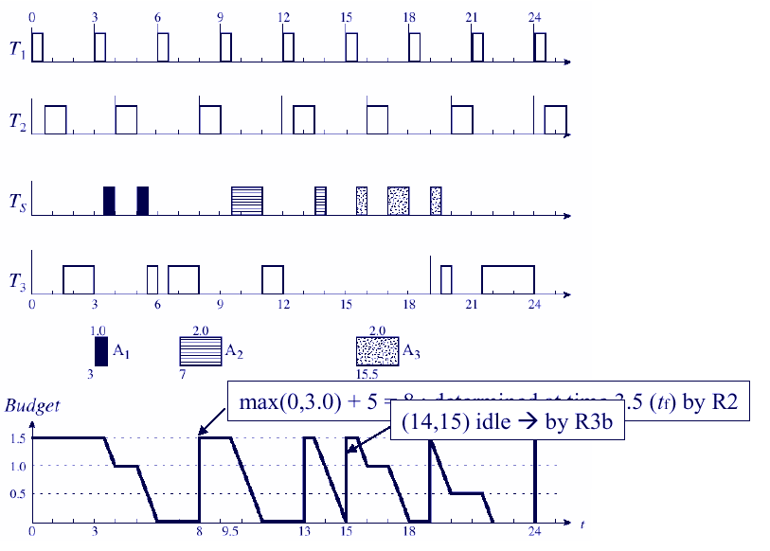
Example T={(3,0.5),(4,1.0),(19,4.5)}, T_{S}=(5,1.5)
set 9_ <number>

Slide 20
Correctness of Simple SS
The Simple SS behaves exactly as a periodic (“real-world” sporadic) task except when R3b is applied (i.e., idle T).
Rule R3b takes advantage of the schedulability test for a fixed-priority periodic task set T.
  We know that if the system T transitions from an idle state to a busy interval, all jobs will make their deadlines – even if they are all released at the same instant (at the start of the new busy interval).
  The replenishment at this instant would not affect schedulability.
set 9_ <number>

Slide 21
SpSL Sporadic Server
A Sporadic Server with priority s is said to be active when it is executing or another task with priority t≥s is executing. Hence, the server remains active even when it is preempted by a higher priority task.
If the server is not active, it is said to be idle
Replenishment Time (RT): it is set as soon as “SS becomes active and the server capacity C_{s}>0”. Let T_{A} be such a time. The value of RT is set equal to T_{A} plus the server period (RT= T_{A}+ p_{s}).
Replenishment Amount (RA): The RA to be done at time RT is computed when “SS becomes idle or the server capacity C_{s} has been exhausted”. Let T_{i} be such a time. The value of RA is set equal to the capacity consumed within the interval [T_{A}, T_{i}].
set 9_ <number>

Slide 22
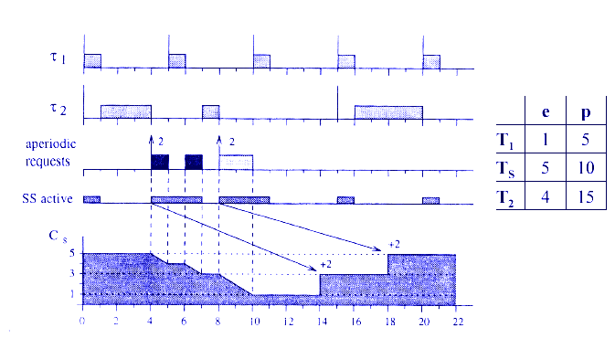
Example of SpSL Sporadic Server
set 9_ <number>

Slide 23
Providing GPS Like service
emulates sporadic task (p_{s}, e_{s})
Scheduling aperiodic tasks in deadline driven systems
Emulate Generalized Processor Sharing (GPS) Algorithm
  provides server an infinitesimally small time slice of length proportional to server size.
Timing isolation
set 9_ <number>

Slide 24
Constant Utilization Servers
Defined by size and instantaneous utilization ũ_{s,}
  d is always defined
  emulates sporadic task with constant ũ_{s}
scheduled with periodic tasks on EDF basis
Consumption rules: consume when executing
Replenishment rules:
  initially e_{s} = 0, d = 0
  aperiodic job (e) arrives at t to empty queue,
    if t < d, do nothin
    else, d = t + e/ ũ_{s}, e_{s} = e
  At deadline (d) of server
    if backlogged, set d = d + e/ ũ_{s}, e_{s} = e
    if idle, do nothing
set 9_ <number>

Slide 25
Total Bandwidth Servers
Improve responsiveness of constant utilization server by using background time
Consumption rules:
  consume only when executing.
Replenishment rules:
  Initially, e_{s} = 0, d = 0
  when aperiodic (e at time t) arrives to empty queue set
  d = max(d, t) + e/u_{s} and e_{s} = e.
  Remove aperiodic job when done and
    server backlogged: d = e/u_{s} and e_{s} = e
    server idle: do nothing.
set 9_ <number>

Slide 26
Weighted Fair Queuing Servers
Goal is to provide fair access to processor
total bandwidth server is not fair (starvation)
same worst case response time as total bandwidth server
non-preemptive version used for network packet scheduling
set 9_ <number>

Slide 27
Slack Stealing Algorithms
aperiodic jobs scheduled using available slack
requires slack computation at each scheduling decision point
  using precomputed or dynamically calculated values
assumes release time jitters are negligible
offers better performance than bandwidth preserving approaches when assumptions are valid
set 9_ <number>

